Slide 1
Section 11.2
The Parabola
Copyright © 2012 Pearson Education, Inc. Publishing as Prentice Hall.

Slide 2
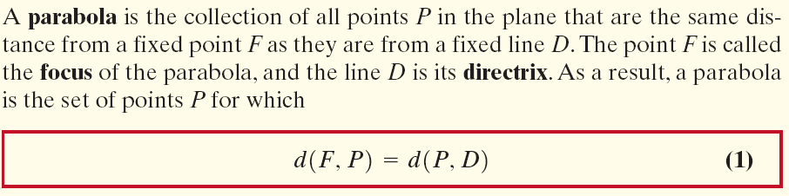
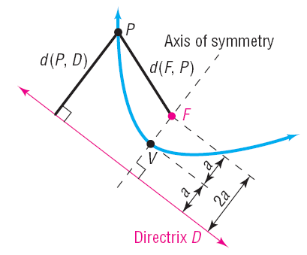
Copyright © 2012 Pearson Education, Inc. Publishing as Prentice Hall.

Slide 3
Copyright © 2012 Pearson Education, Inc. Publishing as Prentice Hall.

Slide 4

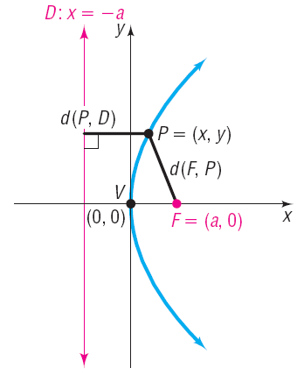

Copyright © 2012 Pearson Education, Inc. Publishing as Prentice Hall.

Slide 5

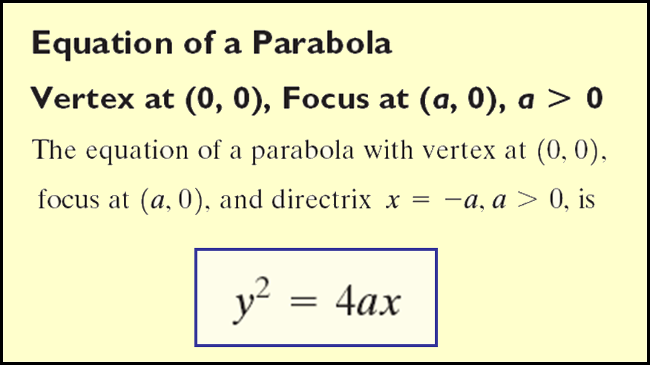
Copyright © 2012 Pearson Education, Inc. Publishing as Prentice Hall.

Slide 6

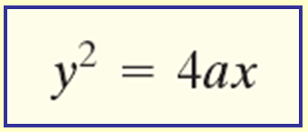


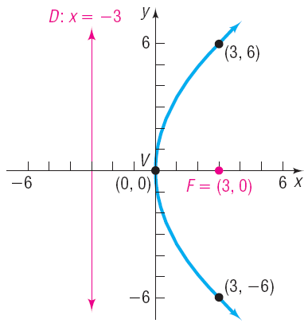
Find an equation of the parabola with vertex at (0, 0) and focus at (3, 0). Graph the equation.
Copyright © 2012 Pearson Education, Inc. Publishing as Prentice Hall.

Slide 7
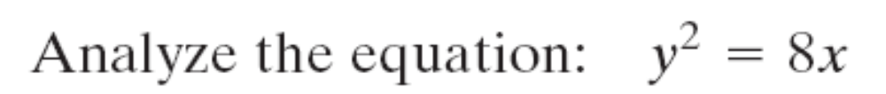
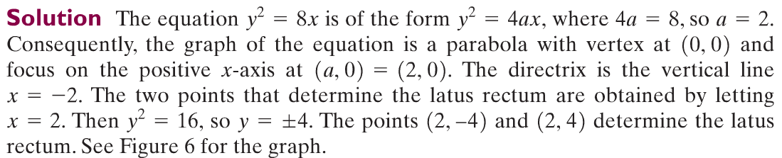
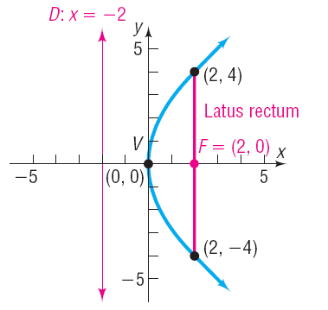
Copyright © 2012 Pearson Education, Inc. Publishing as Prentice Hall.

Slide 8
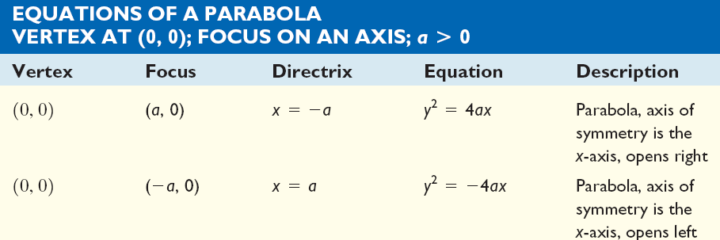
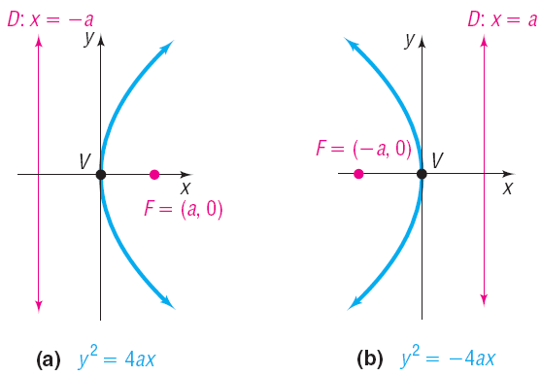
Copyright © 2012 Pearson Education, Inc. Publishing as Prentice Hall.

Slide 9
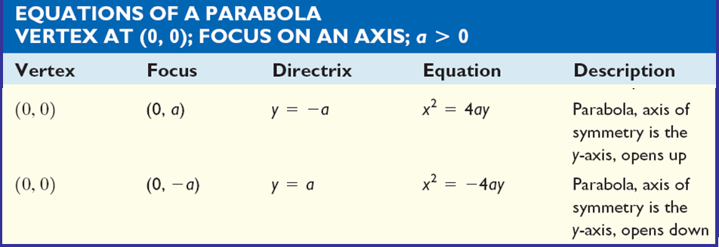
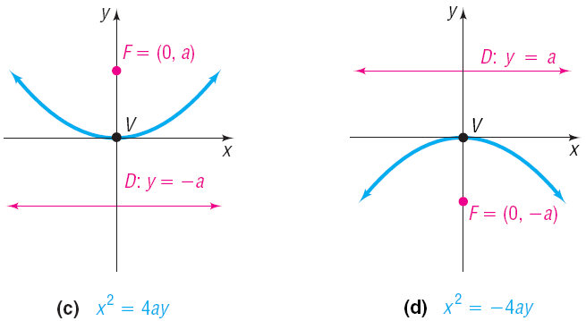
Copyright © 2012 Pearson Education, Inc. Publishing as Prentice Hall.

Slide 10
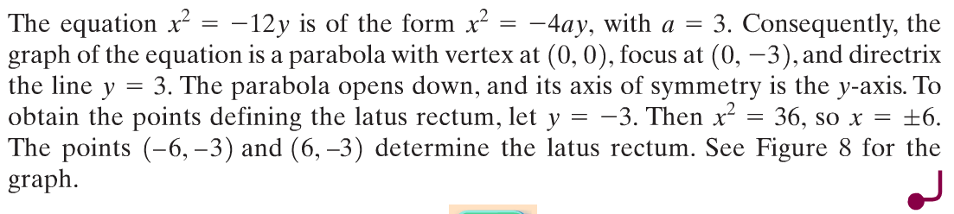
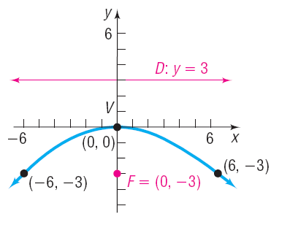
Copyright © 2012 Pearson Education, Inc. Publishing as Prentice Hall.

Slide 11
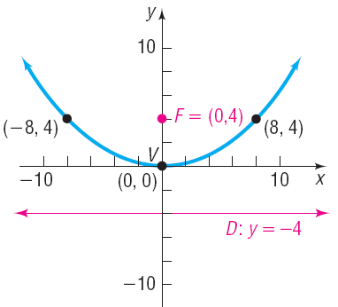
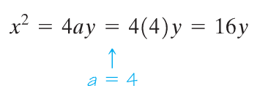


Find the equation of the parabola with focus at (0, 4) and directrix the line y = – 4. Graph the equation.
Copyright © 2012 Pearson Education, Inc. Publishing as Prentice Hall.

Slide 12
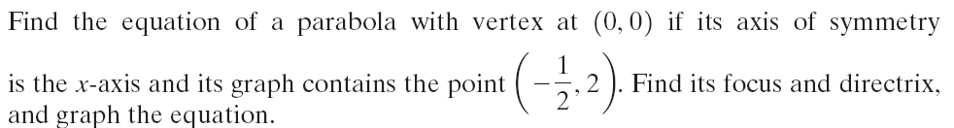
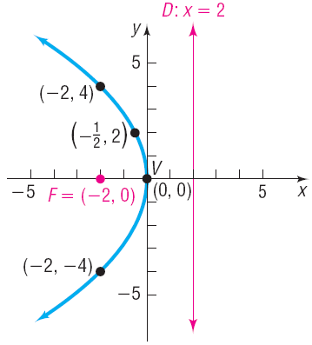
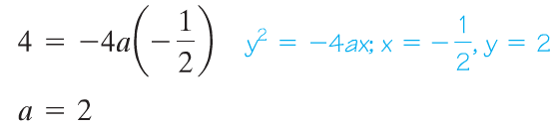

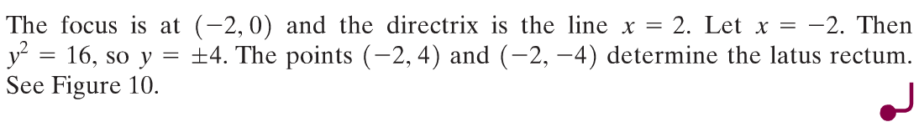

Copyright © 2012 Pearson Education, Inc. Publishing as Prentice Hall.

Slide 13
Copyright © 2012 Pearson Education, Inc. Publishing as Prentice Hall.

Slide 14
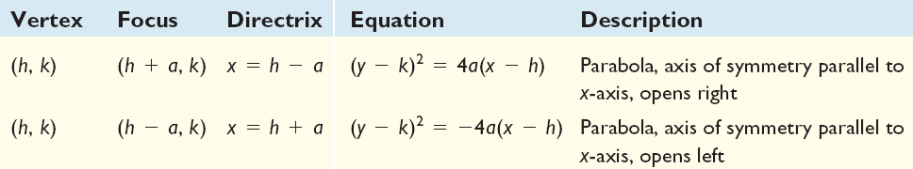
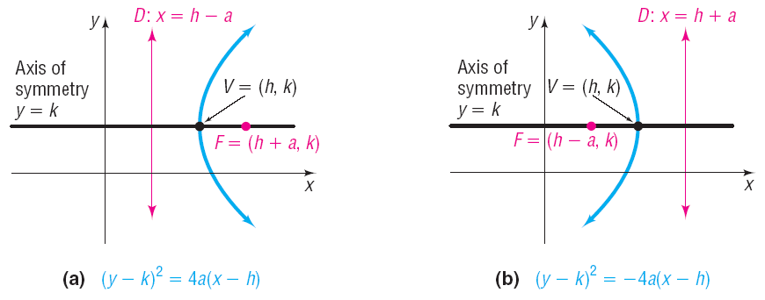
Copyright © 2012 Pearson Education, Inc. Publishing as Prentice Hall.

Slide 15
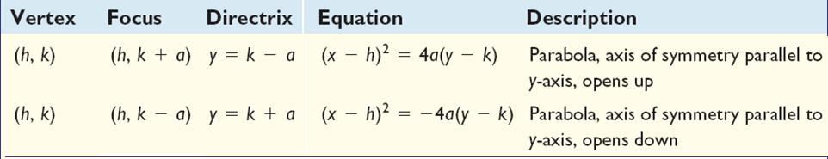
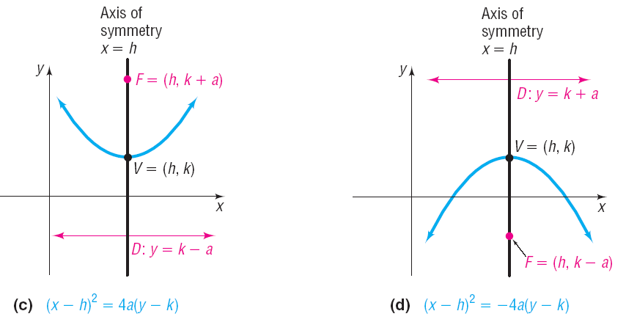
Copyright © 2012 Pearson Education, Inc. Publishing as Prentice Hall.

Slide 16
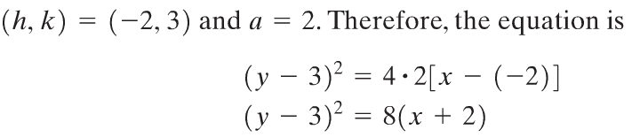
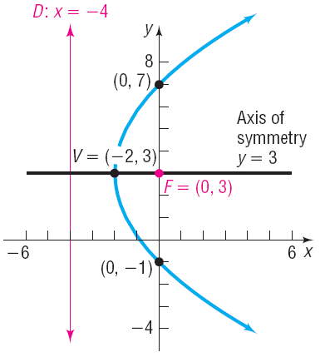
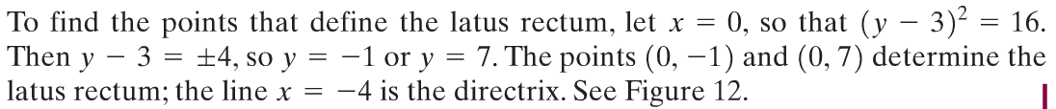

Find an equation of the parabola with vertex at (–2, 3) and focus at (0, 3). Graph the equation.
Copyright © 2012 Pearson Education, Inc. Publishing as Prentice Hall.

Slide 17
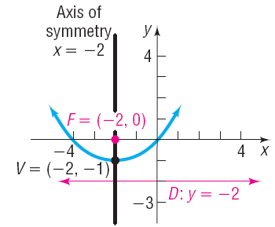



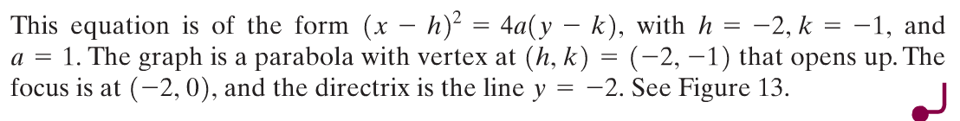

Copyright © 2012 Pearson Education, Inc. Publishing as Prentice Hall.

Slide 18
Copyright © 2012 Pearson Education, Inc. Publishing as Prentice Hall.

Slide 19
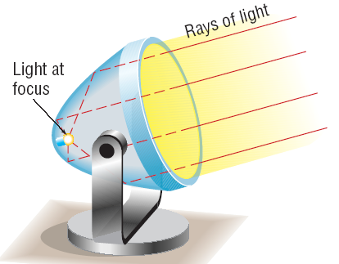
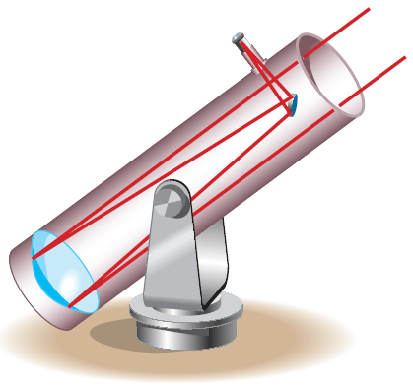


Copyright © 2012 Pearson Education, Inc. Publishing as Prentice Hall.

Slide 20

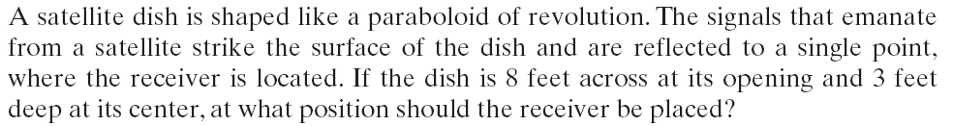
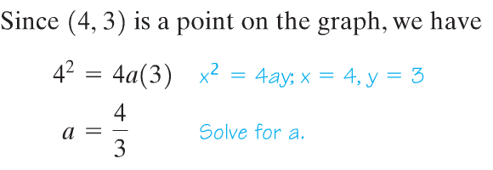
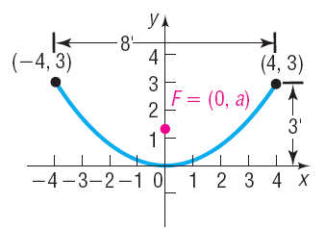
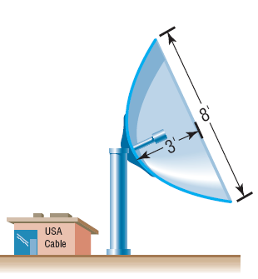
The receiver should be located 1 foot 4 inches from the base of the dish, along its axis of symmetry.
Copyright © 2012 Pearson Education, Inc. Publishing as Prentice Hall.

